Slide 1
FIN 654: FINANCIAL Analytics
SUPPLEMENT Week 2
Note: Code contained here is from a mix of sources as listed in References Slide(s)

Slide 2
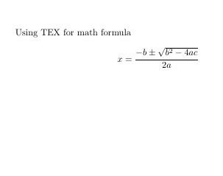
LaTeX (MikTeX or MacTeX)
\documentclass{article}
\begin{document}
Using TEX for math formula
\[
x=\frac{-b\pm\sqrt{b^2-4ac}}{2a}
\]
\end{document}

Slide 3
Pivot and Merge
CreditCard <- read.csv("data/CreditCard.csv")
ccard <- CreditCard[CreditCard$age >= 18, ]
require(dplyr)
## 1: filter to keep three states.
pivot.table <- filter(ccard, state %in% "NY")
## 2: set up data frame for by-group processing.
pivot.table <- group_by(pivot.table, card, owner, selfemp)
## 3: calculate the three summary metrics
(pivot.table <- dplyr::summarise(pivot.table,income.cv = sd(income)/mean(income), age.avg = mean(age), income.per.dependent = sum(income)/sum(dependents)) )
le <- read.csv("data/life_expectancy.csv", header = TRUE, stringsAsFactors = FALSE)
sa <- read.csv("data/sanitation_.csv",
header = TRUE, stringsAsFactors = FALSE)
life.sanitation <- merge(le[, c("country", "years.life.expectancy.avg")], sa[, c("country", "sanitation.avg")])

Slide 4
Functions
## Create a FUNCTION ##
hy <- function (a=3, b=4) {
return (sqrt(a^2 + b^2))
}
hy
## Use (Call) a FUNCTION ##
hy()
hy(6)
hy(,8)
hy(6,8)
####### functions, functions, … everywhere #######
require(car)
scatterplot(mpg ~ wt | cyl, data=mtcars, xlab="Weight of Car", ylab="Miles Per Gallon", main="Enhanced Scatter Plot", labels=row.names(mtcars))
attach(mtcars)
plot(wt, mpg, main="Scatterplot Example", xlab="Car Weight ", ylab="Miles Per Gallon ", pch=19)
abline(lm(mpg~wt), col="red") # regression line (y~x)
lines(lowess(wt,mpg), col="blue") # lowess line (x,y)
detach(mtcars)

Slide 5
Moments IN STATISTICS
data_moments <- function(data) {
require(moments)
median.r <- median(data)
mean.r <- mean(data)
sd.r <- sd(data)
skewness.r <- skewness(data)
kurtosis.r <- kurtosis(data)
result <- data.frame(mean = mean.r, std_dev = sd.r, median = median.r, skewness = skewness.r, kurtosis = kurtosis.r)
return(result)
}
ans <- data_moments(xmprice.r.df$Rate.abs)
ans <- round(ans, 4)
knitr::kable(ans)
###################################
The third moment → skewness
If skewness = 0, the data are perfectly symmetrical . If skewness > 0, the data are positively skewed or skewed right. If skewness < 0, the data are negatively skewed or skewed left.
The fourth moment → kurtosis
Traditionally, kurtosis has been explained in terms of the central peak. But, it’s the tails that mostly account for kurtosis, not the central peak.

Slide 6
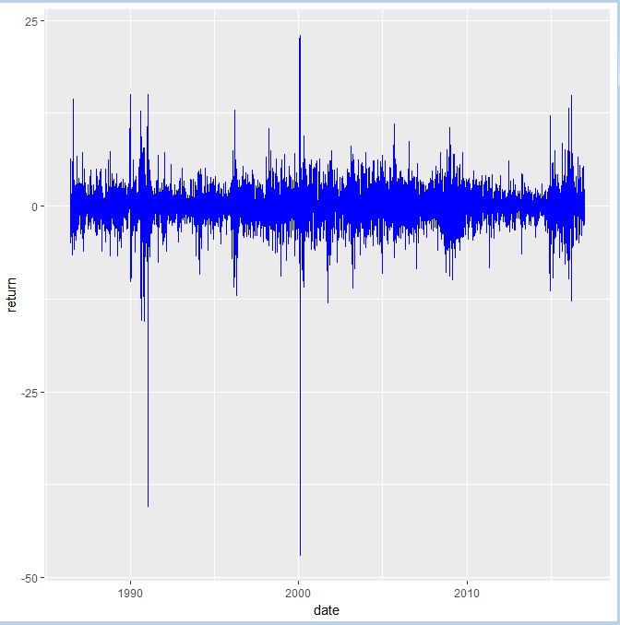
Price and Returns
HO2 <- na.omit(read.csv("data/nyhh02.csv", header = T, stringsAsFactors = F))
return <- as.numeric(diff(log(HO2$DHOILNYH))) * 100
size <- as.numeric(abs(return))
direction <- ifelse(return > 0, "up", ifelse(return < 0, "down", "same"))
date <- as.Date(HO2$DATE[-1], "%m/%d/%Y")
price <- as.numeric(HO2$DHOILNYH[-1])
HO2.df <- na.omit(data.frame(date = date, price = price, return = return, size = size, direction = direction))
require(ggplot2)
ggplot(HO2.df, aes(x = date, y = return, group = 1)) + geom_line(colour = "blue")

Slide 7
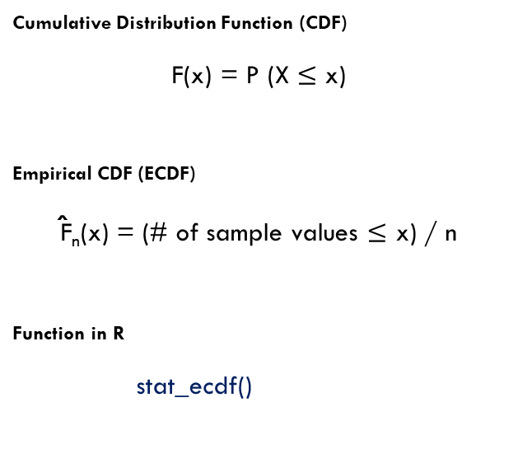
Empirical CDF or Sample CDF
Cumulative Distribution Function (CDF)
F(x) = P (X $≤$ x)
Empirical CDF (ECDF)
F̂_{n}(x) = (# of sample values $≤$ x) / n
Function in R
stat_ecdf()
Facts about ECDF
The empirical CDF is a sample CDF
The empirical CDF is a non-parametric unbiased estimate of the population CDF.
The mean or expected value of the empirical CDF corresponds to the true underlying CDF.
The empirical CDF is different from the true CDF because of random variation.
The empirical CDF is used as a consistent estimator of the true CDF at any value of x.

Slide 8
Application of ECDF
require(xts)
require(zoo)
xmprice <- na.omit(read.csv("data/EIUIR.csv"))
xmprice.r <- as.zoo(na.omit((diff(log(xmprice$Value))))) ## compute rates
xmprice.r.df <- data.frame(xmprice.r, Date = index(xmprice.r), Rate = xmprice.r[, 1], Rate.abs <- abs(xmprice.r[, 1]))
require(ggplot2)
ggplot(xmprice.r.df, aes(x = Date, y = Rate)) + geom_line(colour = "blue")
require(ggplot2)
r.tol.pct <- 0.95
r.tol <- quantile(xmprice.r.df$Rate, r.tol.pct)
r.tol.label <- paste("Tolerable Rate = ",
round(r.tol, 2))
ggplot(xmprice.r.df, aes(Rate)) + stat_ecdf(colour = "blue", size = 1.5) + geom_vline(xintercept = r.tol,
colour = "red", size = 1.5) + annotate("text", x = r.tol - 0.05, y = 0.75, label = r.tol.label,
colour = "darkred")

Slide 9
Method of Moments (MOM) & Maximum Likelihood Estimation (MLE)
################################### Moments of the data match the Moments of the distribution ###################################
cost <- read.csv("data/cost.csv")
cost <- cost$x
cost.moments <- data_moments(cost)
cost.mean <- cost.moments$mean
cost.sd <- cost.moments$std_dev
(cost.shape <- cost.mean^2/cost.sd^2)
(cost.scale <- cost.sd^2/cost.mean)
gamma.start <- c(cost.shape, cost.scale)
################################### Fitting Distributions by Maximum Likelihood Estimation ###################################
require(MASS)
fit.gamma.cost <- fitdistr(cost, "gamma")
fit.gamma.cost
(cost.t <- fit.gamma.cost$estimate/fit.gamma.cost$sd)
knitr::kable(cost.t)
################################### Another available function in R is stdFit (fGarch package) ###################################

Slide 10
Reference books
Bennet and Hugen. 2016. Financial Analytics with R: Cambridge Univ Press.
Paul Teetor. 2011. R Cookbook. O’Reilly: Sebastopol, CA.
Phil Spector. Data Manipulation with R.
Norman Matloff. The Art of R Programming: A Tour of Statistical Software Design.
John Taveras. R for Excel Users at https://www.rforexcelusers.com/book/.
Winston Chang. 2014. R Graphics Cookbook. O’Reilly: Sebastopol, CA.

Slide 11
Reference links
http://www.cookbook-r.com/
https://books.google.com/books?id=fxL4tu5bzAAC&printsec=frontcover
https://www.datacamp.com/courses/free-introduction-to-r
http://www.r-tutor.com/r-introduction/
https://www.statmethods.net/
https://livebook.manning.com/#!/book/r-in-action-second-edition/
https://blog.rstudio.com/2015/06/24/leaflet-interactive-web-maps-with-r/
https://www.analyticsvidhya.com/blog/2015/07/guide-data-visualization-r/
https://jabranham.com/blog/2015/09/rmarkdown-vs-latex/
https://www.revolvy.com/main/index.php?s=YAML

